Slide 1
Regression Algorithms & Time Series

Slide 2


Grandma’s homemade ml model (pt.2)

Slide 3
ingredients
Data – The main ingredient, like rice or flour. The quality and quantity of data determine how good the final dish (model) will be.
Features – Like chopped vegetables or spices, these are extracted from raw data to enhance the model’s performance.
Algorithms – The recipe or cooking technique, deciding how the ingredients are combined (e.g., linear regression, decision trees, neural networks).
Hyperparameters – The seasoning and cooking conditions (e.g., learning rate, batch size) that fine-tune the final output.
Computational Power – The heat source (CPU, GPU, TPU) that makes the cooking (training) possible.

Slide 4
Regression algorithms are a type of machine learning algorithm used to predict numerical values based on input data. Regression algorithms attempt to find a relationship between the input variables and the output variable by fitting a mathematical model to the data. The goal of regression is to find a mathematical relationship between the input features and the target variable that can be used to make accurate predictions on new, unseen data.
Types of Regression:
Linear regression
Logistic regression
Polynomial regression
Lasso regression
Ridge regression
ElasticNet regression
Quantile regression
Poisson regression
Simple linear regression
Support Vector Regression
Bayesian linear regression
Principal components regression
Decision tree regression
Nonlinear regression
Ordinal
Stepwise regression
Corrective regression testing
Logistic regression analysis
Random Forest regression
Multiple regression
Partial least squares regression
Negative binomial regression
Cox regression
Huber regression

Slide 5
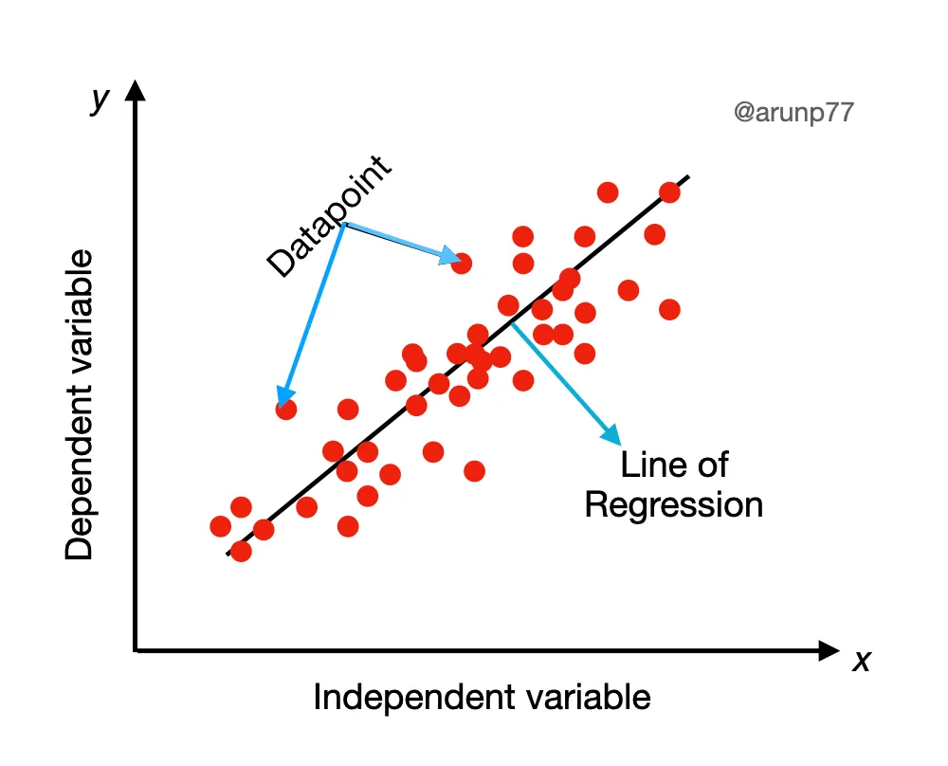
Linear regression
Linear regression is a simple and widely used algorithm. It assumes a linear relationship between the independent variables and the target variable. The algorithm estimates the coefficients of the linear equation that best fits the data. The equation can be of the form: y= m x +c, where y is the target variable, x is the input feature, m is the slope, and c is the intercept.
Example: applications include predicting housing prices based on features like square footage and number of bedrooms or estimating sales based on advertising expenditure.

Slide 6
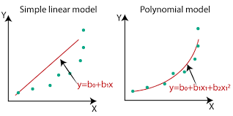
Polynomial regression
Polynomial regression is an extension of linear regression where the relationship between the variables is modeled using a polynomial equation. This allows for more flexibility in capturing nonlinear relationships between the input features and the target variable. It involves adding polynomial terms, such as x² or x³, to the linear equation. Polynomial regression is useful when the data exhibits curvilinear patterns.
Example: predicting the yield of a crop based on factors such as temperature, humidity, and rainfall.

Slide 7
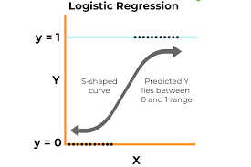
Logistic regression
Logistic regression is a popular algorithm used for binary classification problems where the target variable has two possible outcomes (e.g., yes/no, true/false, 0/1). Despite its name, logistic regression is a classification algorithm, not a regression algorithm. It models the relationship between the independent variables (input features) and the binary target variable using the logistic function, also known as the sigmoid function.
Example: predicting whether a customer will churn (i.e., stop doing business with a company) based on their demographic information and purchase history.

Slide 8
ridge regression
Ridge regression is a regularization technique that addresses the issue of overfitting in linear regression. It adds a penalty term to the linear regression equation to control the complexity of the model. This penalty term helps prevent the coefficients from becoming too large, reducing the model’s sensitivity to the training data. Ridge regression is particularly useful when dealing with high-dimensional data or when multicollinearity (high correlation) exists among the input features
Example: predicting the price of a stock based on financial indicators such as earnings per share and price-to-earnings ratio.

Slide 9
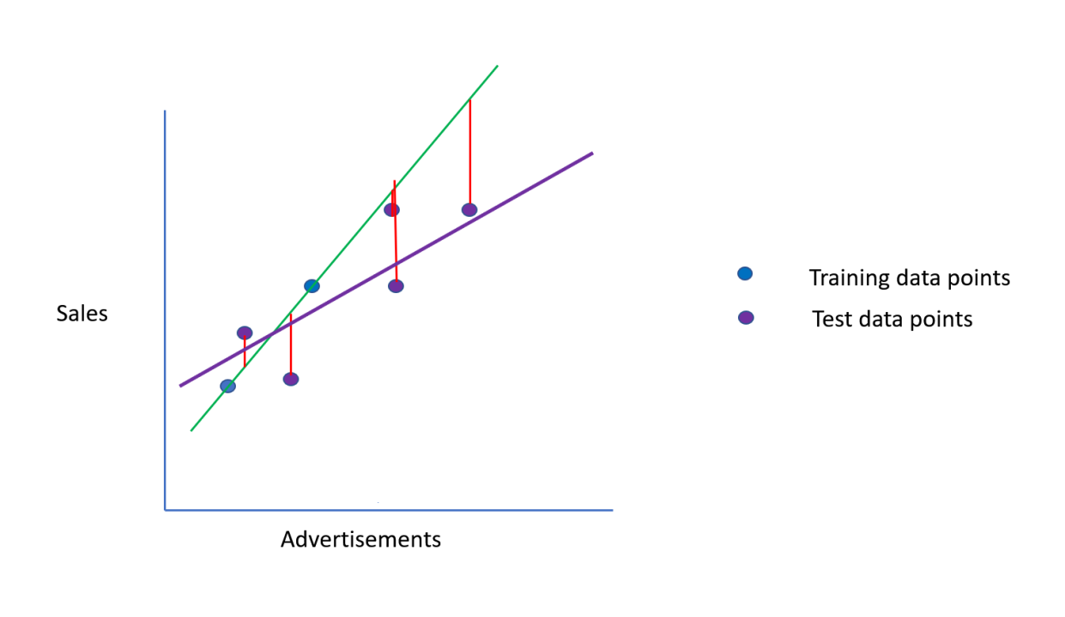
Lasso regression
Lasso regression, similar to ridge regression, is a regularization technique used to combat overfitting. It adds a penalty term to the linear regression equation, but in this case, it uses the L1 norm of the coefficients as the penalty. Lasso regression has a feature selection property that can drive some coefficients to zero, effectively performing automatic feature selection. This makes it useful when dealing with datasets with many features or when looking to identify the most influential variables.
Example: predicting the likelihood of a customer purchasing a product based on their browsing and purchase history on a website.

Slide 10
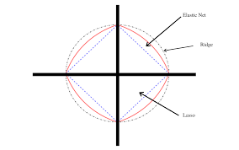
Elastic net regression
ElasticNet regression combines both ridge and lasso regularization techniques. It adds a penalty term that is a linear combination of the L1 (lasso) and L2 (ridge) norms of the coefficients. This hybrid approach allows for feature selection while also providing stability and reducing the impact of multicollinearity. ElasticNet regression is useful when there are many correlated features, and the goal is to select relevant features and mitigate multicollinearity.
Example: predicting the demand for a product based on factors such as price, advertising spend, and competitor activity.

Slide 11

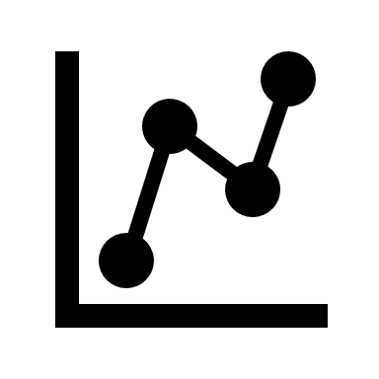
Time series analysis

Slide 12
Time series analysis is a specific way of analyzing a sequence of data points collected over an interval of time. In time series analysis, analysts record data points at consistent intervals over a set period of time rather than just recording the data points intermittently or randomly
Time series analysis typically requires a large number of data points to ensure consistency and reliability. An extensive data set ensures you have a representative sample size and that analysis can cut through noisy data. It also ensures that any trends or patterns discovered are not outliers and can account for seasonal variance. Additionally, time series data can be used for forecasting—predicting future data based on historical data.
While time series data is data collected over time, there are different types of data that describe how and when that time data was recorded. For example:
Time series data is data that is recorded over consistent intervals of time.
Cross-sectional data consists of several variables recorded at the same time.
Pooled data is a combination of both time series data and cross-sectional data.

Slide 13
Further, time series data can be classified into two main categories:
1) Stock time series data : means measuring attributes at a certain point in time, like a static snapshot of the information as it was.
2) Flow time series data : means measuring the activity of the attributes over a certain period, which is generally part of the total whole and makes up a portion of the results.
Wait a minute!! Stock time series data…certain point in time?? Wasn’t cross sectional data the same??
Well, one might get confused so here’s the Key Difference:
- Cross-sectional data compares different entities at a single point in time.
- Time series data tracks one entity’s changes over time.

Slide 14
Components of Time Series Data
Trend: Trend represents the long-term movement or directionality of the data over time. It captures the overall tendency of the series to increase, decrease, or remain stable. Trends can be linear, indicating a consistent increase or decrease, or nonlinear, showing more complex patterns.
Seasonality: Seasonality refers to periodic fluctuations or patterns that occur at regular intervals within the time series. These cycles often repeat annually, quarterly, monthly, or weekly and are typically influenced by factors such as seasons, holidays, or business cycles.
Cyclic variations: Cyclical variations are longer-term fluctuations in the time series that do not have a fixed period like seasonality. These fluctuations represent economic or business cycles, which can extend over multiple years and are often associated with expansions and contractions in economic activity.
Irregularity (or Noise): Irregularity, also known as noise or randomness, refers to the unpredictable or random fluctuations in the data that cannot be attributed to the trend, seasonality, or cyclical variations. These fluctuations may result from random events, measurement errors, or other unforeseen factors. Irregularity makes it challenging to identify and model the underlying patterns in the time series data.

Slide 15
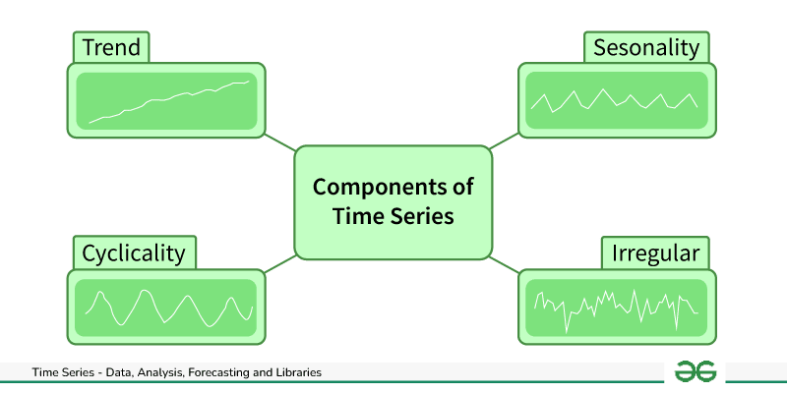

Slide 16
Time Series Visualization
Line Plots: Line plots display data points over time, allowing easy observation of trends, cycles, and fluctuations (check code here: Read here).
Seasonal Plots: These plots break down time series data into seasonal components, helping to visualize patterns within specific time periods (check code here: Read here).
Histograms and Density Plots: Shows the distribution of data values over time, providing insights into data characteristics such as skewness and kurtosis.
Autocorrelation and Partial Autocorrelation Plots: These plots visualize correlation between a time series and its lagged values, helping to identify seasonality and lagged relationships.
Spectral Analysis: Spectral analysis techniques, such as periodograms and spectrograms, visualize frequency components within time series data, useful for identifying periodicity and cyclical patterns (check code here: Read here).
Decomposition Plots: Decomposition plots break down a time series into its trend, seasonal, and residual components, aiding in understanding the underlying patterns (check code here: Read here).

Slide 17
Time Series Analysis & Decomposition techniques
Autocorrelation Analysis: A statistical method to measure the correlation between a time series and a lagged version of itself at different time lags. It helps identify patterns and dependencies within the time series data.
Partial Autocorrelation Functions (PACF): PACF measures the correlation between a time series and its lagged values, controlling for intermediate lags, aiding in identifying direct relationships between variables.
Trend Analysis: The process of identifying and analyzing the long-term movement or directionality of a time series. Trends can be linear, exponential, or nonlinear and are crucial for understanding underlying patterns and making forecasts.
Seasonality Analysis: Seasonality refers to periodic fluctuations or patterns that occur in a time series at fixed intervals, such as daily, weekly, or yearly. Seasonality analysis involves identifying and quantifying these recurring patterns to understand their impact on the data.
Decomposition: Decomposition separates a time series into its constituent components, typically trend, seasonality, and residual (error). This technique helps isolate and analyze each component individually, making it easier to understand and model the underlying patterns.

Slide 18
Time Series Analysis & Decomposition techniques
Spectrum Analysis: Spectrum analysis involves examining the frequency domain representation of a time series to identify dominant frequencies or periodicities. It helps detect cyclic patterns and understand the underlying periodic behavior of the data.
Seasonal and Trend decomposition using Loess: STL decomposes a time series into three components: seasonal, trend, and residual. This decomposition enables modeling and forecasting each component separately, simplifying the forecasting process.
Rolling Correlation: Rolling correlation calculates the correlation coefficient between two time series over a rolling window of observations, capturing changes in the relationship between variables over time.
Cross-correlation Analysis: Cross-correlation analysis measures the similarity between two time series by computing their correlation at different time lags. It is used to identify relationships and dependencies between different variables or time series.
Box-Jenkins Method: Box-Jenkins Method is a systematic approach for analyzing and modeling time series data. It involves identifying the appropriate autoregressive integrated moving average (ARIMA) model parameters, estimating the model, diagnosing its adequacy through residual analysis, and selecting the best-fitting model.
Granger Causality Analysis: Granger causality analysis determines whether one time series can predict future values of another time series. It helps infer causal relationships between variables in time series data, providing insights into the direction of influence.

Slide 19

Resources
https://arunp77.medium.com/regression-algorithms-29f112797724
https://www.tableau.com/analytics/what-is-time-series-analysis https://www.geeksforgeeks.org/time-series-analysis-and-forecasting/

